Slide 1
Project 1
Stock Market

Slide 2
Problem statement
Client is looking to invest in different sector and selected the Aerospace & Defense
What company should the client invest in?

Slide 3
data
Companies analyzed:
RTX (Raytheon)
GD (General Dynamics)
LMT (Lockheed)
SPY500
All selected companies had outstanding dividend payout last year.
Sources:
https://data.nasdaq.com
https://api.marketstack.com

Slide 4
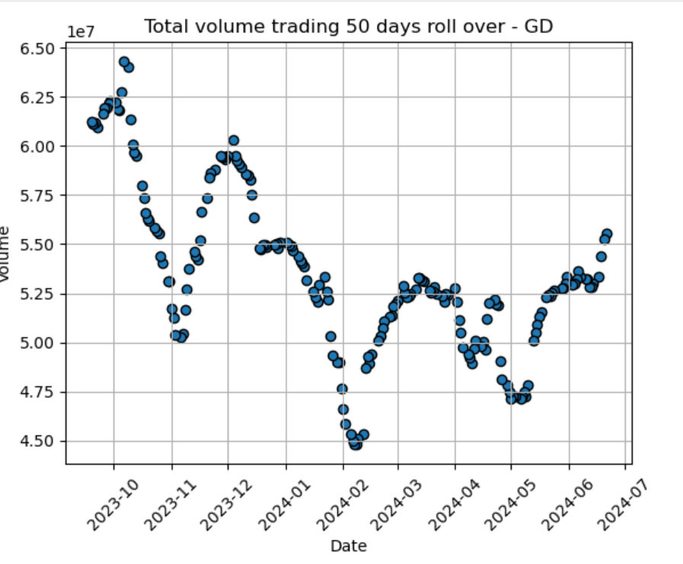
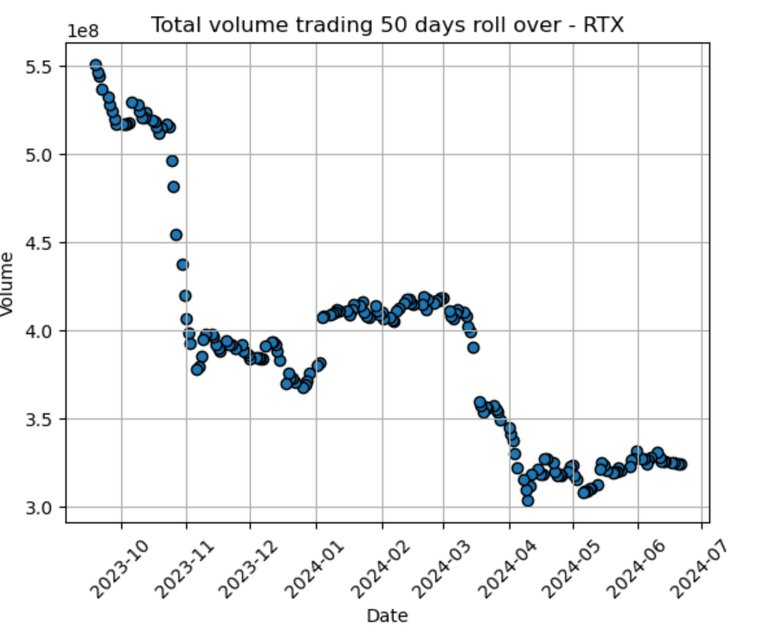
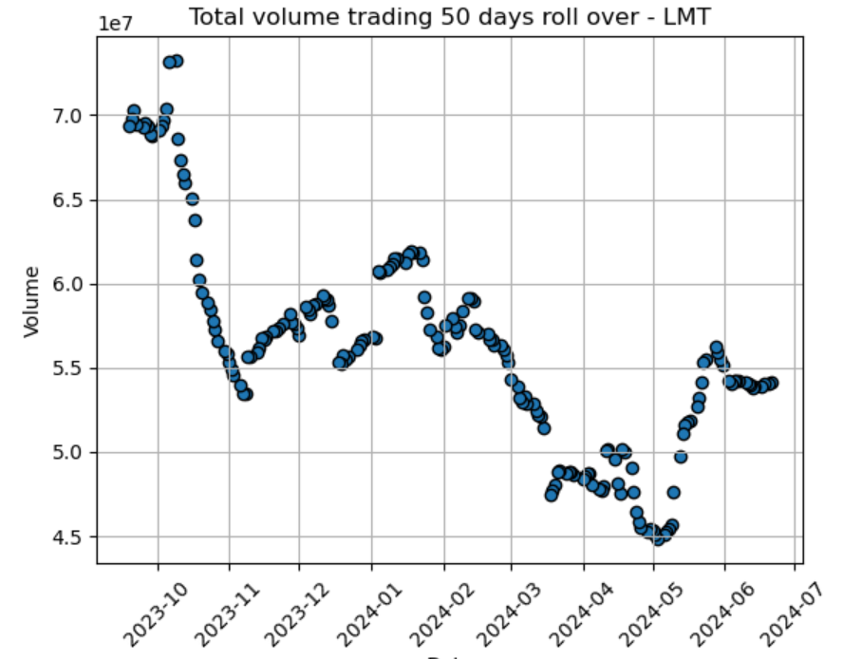
Total Volume trading

Slide 5
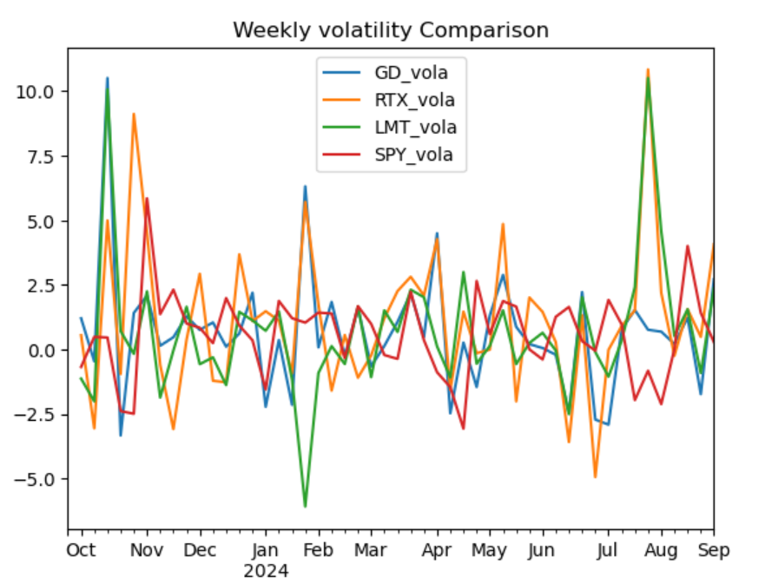
Weekly volatility comparison

Slide 6
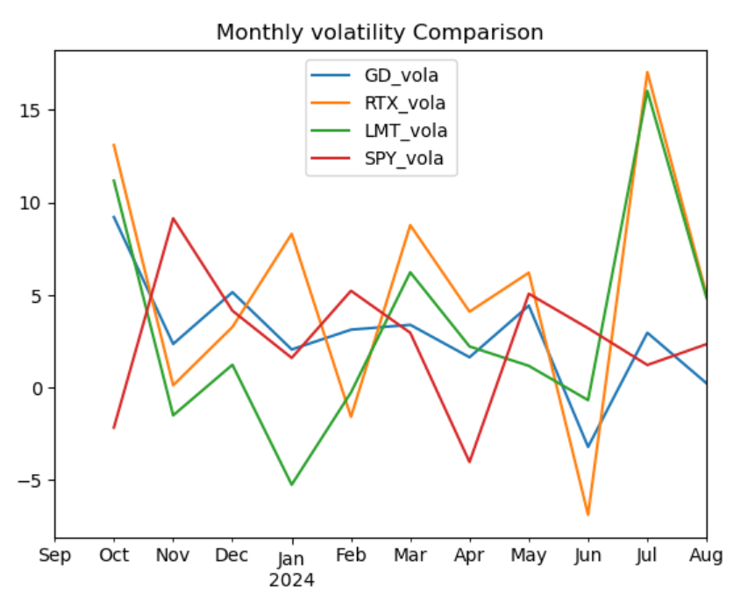
monthly volatility comparison

Slide 7
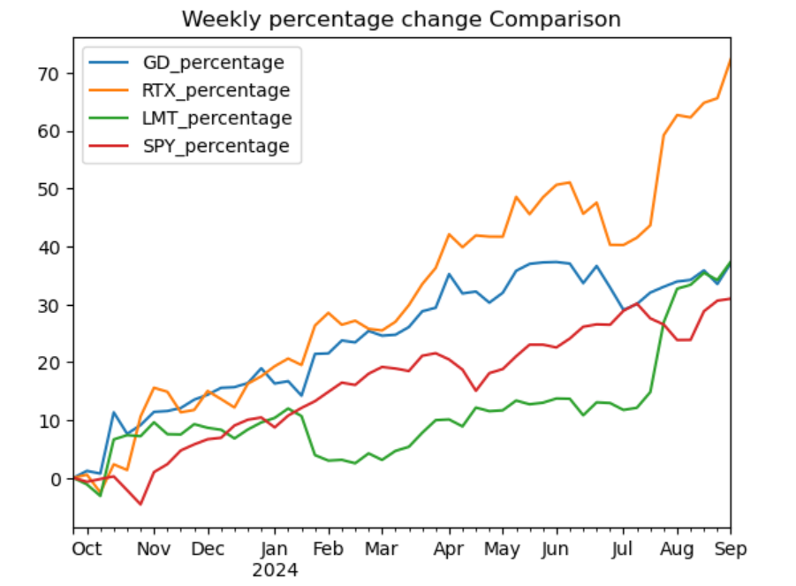
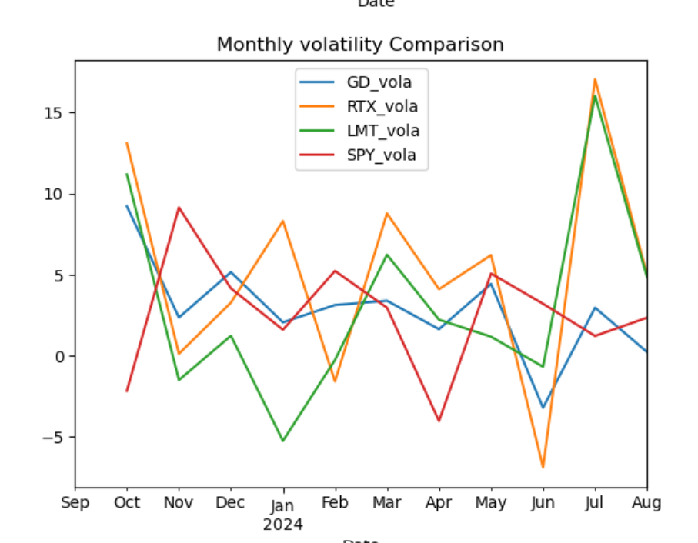
PERCENT CHANGE

Slide 8
CONCLUSION
We recommend to invest in GD (General Dynamics), the company has the lowest risk. Low price volatility and high total volume trading.

